Slide 1
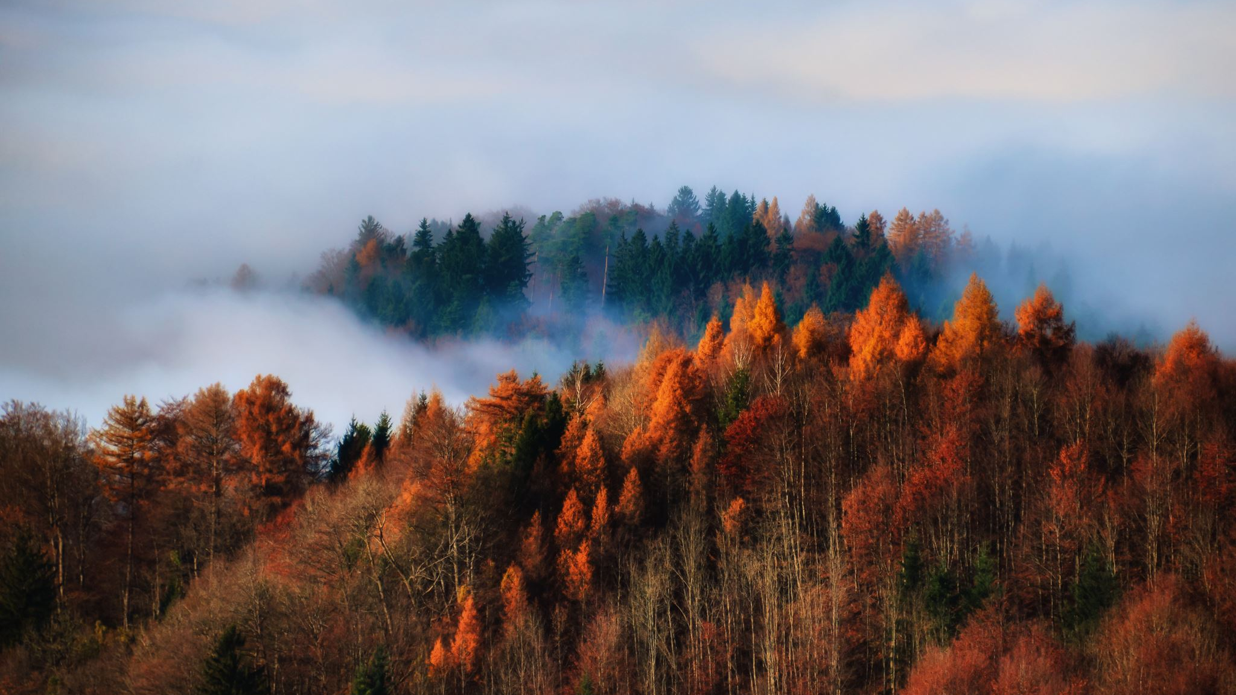
US Wildfires
An analysis of Data collected over 23 years

Slide 2
Topic Overview
Background
Problem
Dataset
Analysis

Slide 3
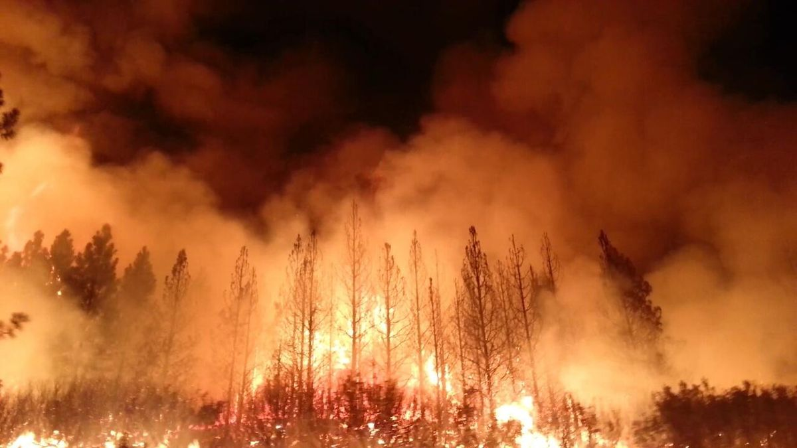
Forest fires are a major environmental issue, creating economic and ecological damage while endangering human lives.
Fast detection is a key element for controlling such a phenomenon
Each year millions of forest hectares are destroyed all around the world.
In California alone, we witnessed some of the deadliest and most destructive fires in state history. 98 civilians and 6 firefighters lost their lives.
In total, a staggering 1.9 million acres were burnt, with the loss of over 10,300 structures, and incurred more than $3.5 billion in damages
A further $1.8 billion was spent by the various agencies to control and extinguish the fires.
Wildfires are costly events, in so many ways. The objective of this potential project would be to identify What counties are the most fire-prone and to predict the cause of a wildfire

Slide 4
Problems
Is Global warming affecting the number of fires? Has the number of fires increased over the period 1992-2015?
Are we able to limit fire spread with help of growing technology? Has the size of fire decreased over years?
What causes the most fires? Which causes are associated with larger wildfires?
Which State in the USA is most affected by Wildfires? Which county is more prone or less prone to Wildfire?
What is causing more fires in each state?

Slide 5
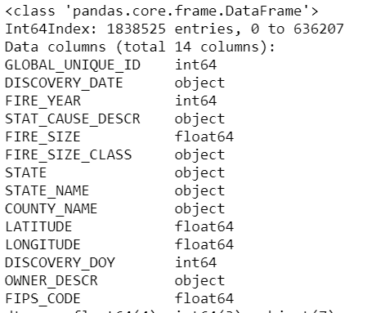
Dataset
This data publication contains a spatial database of wildfires that occurred in the United States from 1992 to 2015.
It includes 1.88 million geo-referenced wildfire records, representing a total of 140 million acres burned during the 24 years.
14 relevant features and 1838525 entries were focused.

Slide 6
Data Wrangling
Dropped columns in SQL table "fires” which were related to Source of data and agency information which collected or prepared reports on Data.
Dropped columns with more than 50% of its total data with null values.
Filled the missing values of COUNTY_NAME column using 'LATITUDE' and 'LONGITUDE' columns
Converted "DISCOVERY_DATE“ column to a readable date format from Julian date.
Created a column FIPS_CODE with FIPS code value for each County Name.
Checked if there were any outliers with respect to the FIRE_YEAR column

Slide 7
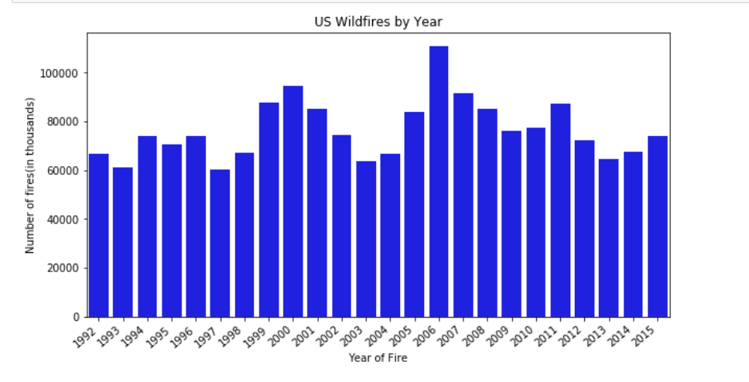
Number of fires over the period of 1992-2015.
The number of fires per year ran between 60,000 and 100,000 from 1992 to 2015.
There was a spike in fires in 2006.
Though we can see a small upward trend at certain time periods, there is no continuous upward trend over the period.

Slide 8
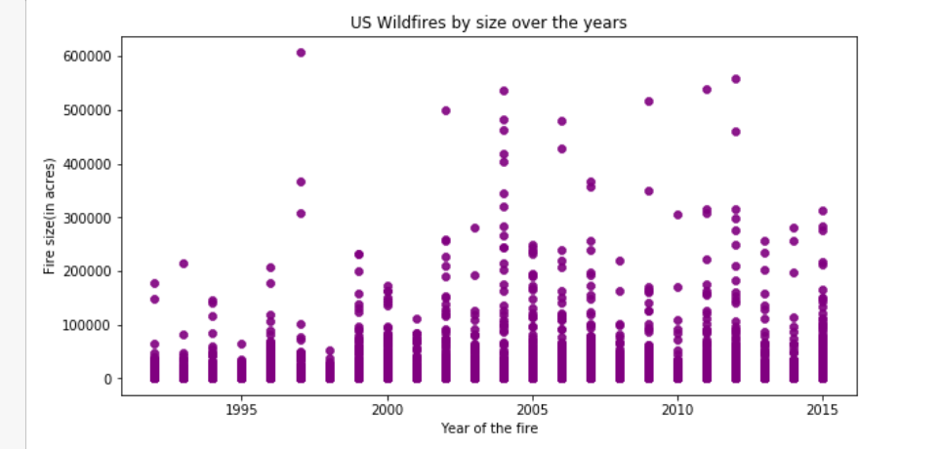
Wildfire size over the years
There is no decrease or increase of fire size from 1992-2015.
Every year has recorded fire of different sizes.

Slide 9
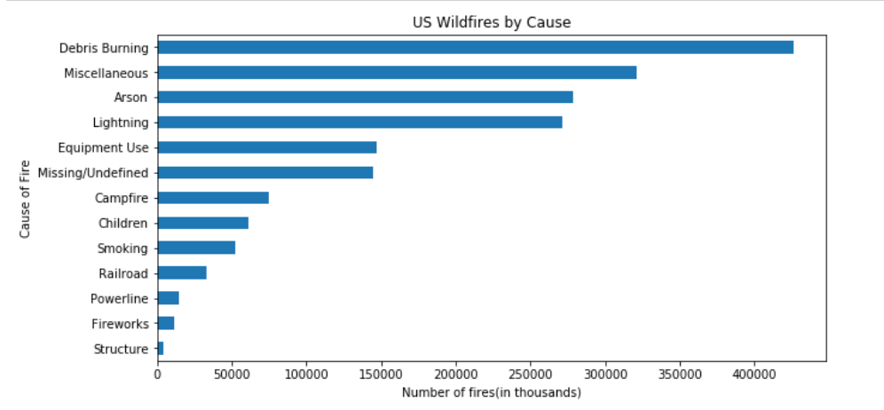
What causes the most fires?
Trash burning was the largest cause of wildfire by a significant margin.
Slightly more fires were started by arson than by lightning
Interesting to note that one reason is just ‘Children’.

Slide 10
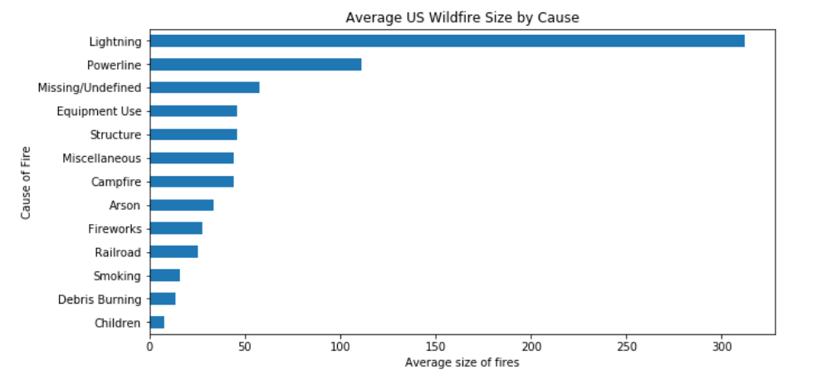
Relationship between cause and fire size?
We can observe that fires started by ‘Lightning’ are the most damaging.
Though the number of fires caused by debris burning is large in number, the average size of the fire caused by it is very low.

Slide 11
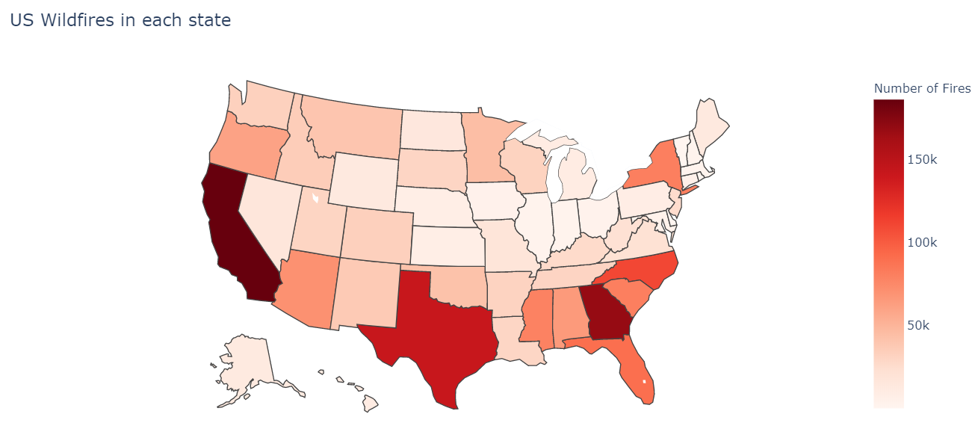
Wildfires in each state of USA
California and Texas have the most wildfires.
Surprisingly, Georgia which is much smaller state than Texas has larger number of wildfires than Texas.

Slide 12
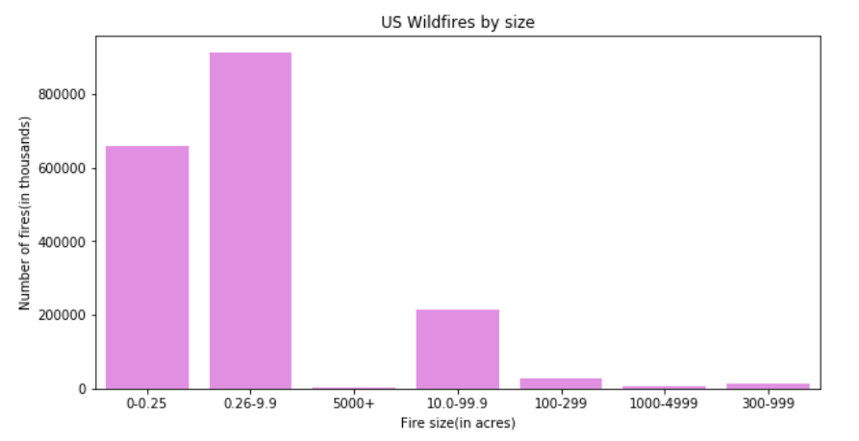
Wildfires by size
Over 800k of total fire incidents are in between 0.26-0.99 acres within the final fire perimeter expenditures.
The number of wildfires reported which have caused damage to more than 1000 acres are comparatively less

Slide 13
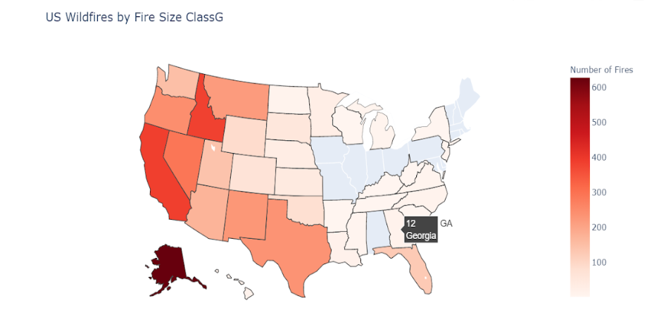
Wildfires in each state with respect to fire size
From Dataset we know that
Size 'A' represents '0-0.25' acres
Size 'B' represents '0.26-9.9' acres
Size 'C' represents '10.0-99.9' acres
Size 'D' represents '100-299' acres
Size 'E' represents '300-999' acres
Size 'F' represents '000-4999' acres
Size 'G' represents '5000+' acres.
Georgia has 12 fires over the span of two decades which are of size ‘5000”’ acres
Alaska has the large number of fires of largest size

Slide 14
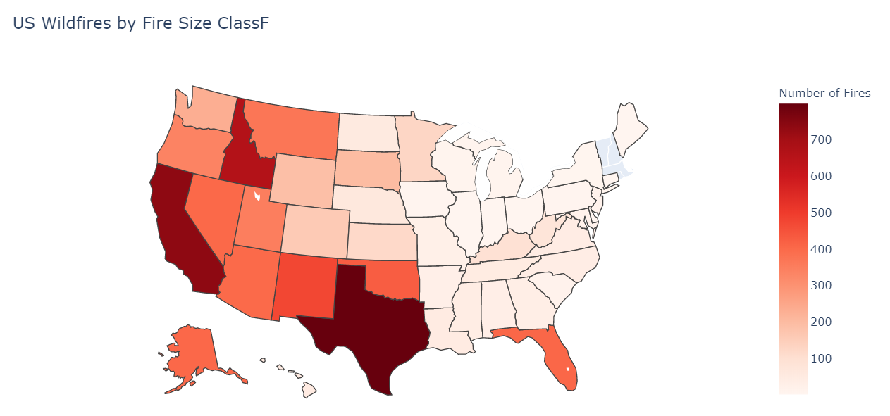
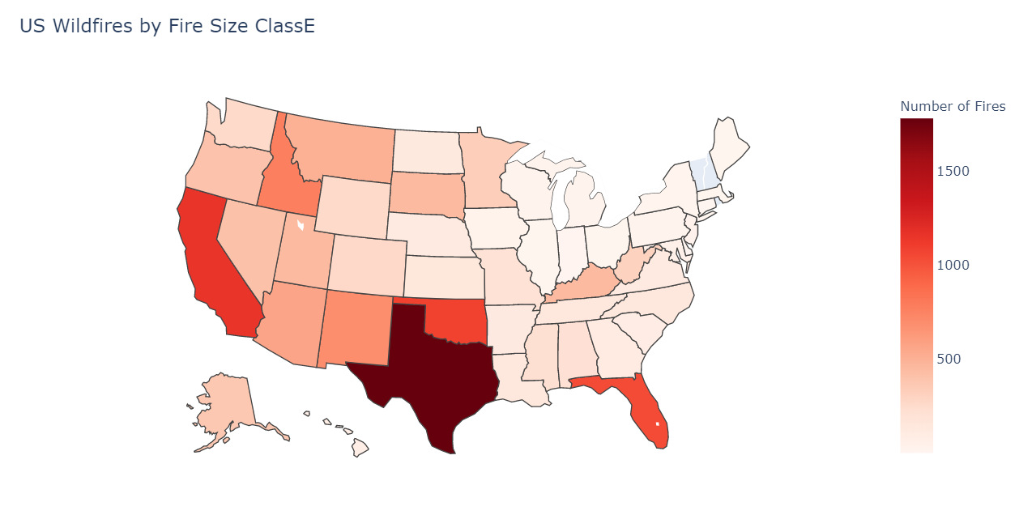
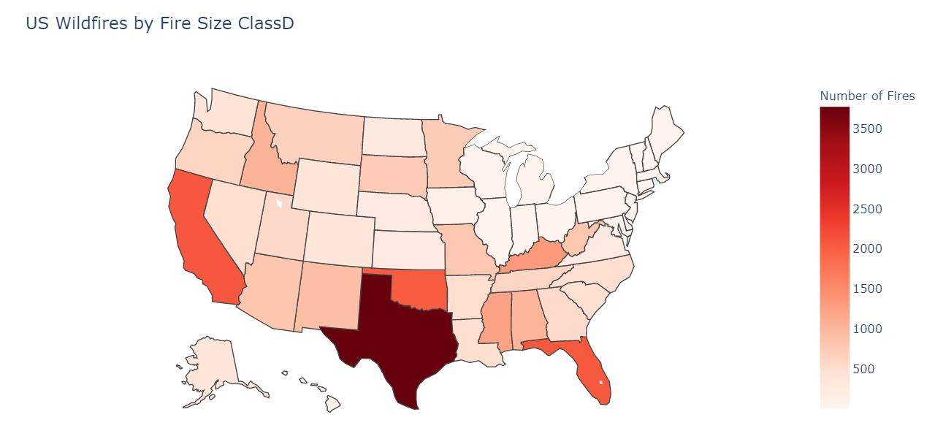
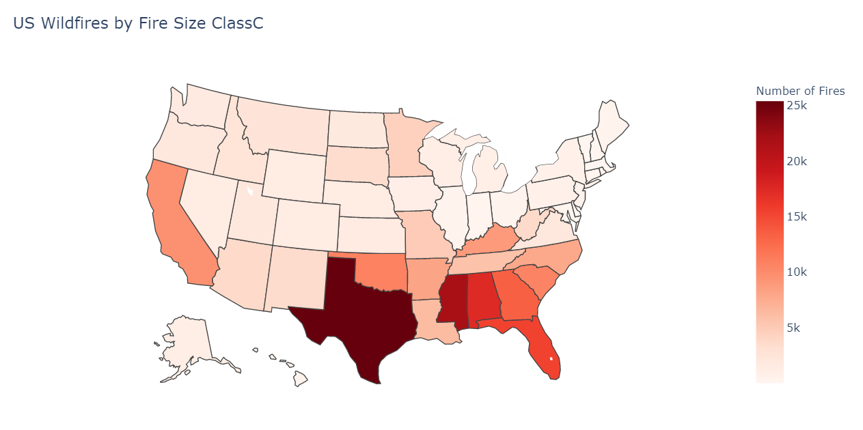

Slide 15
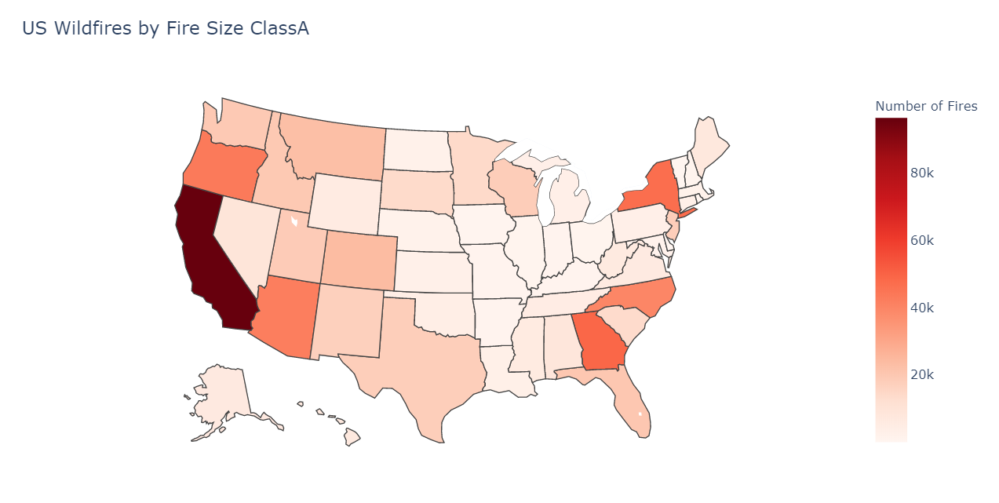
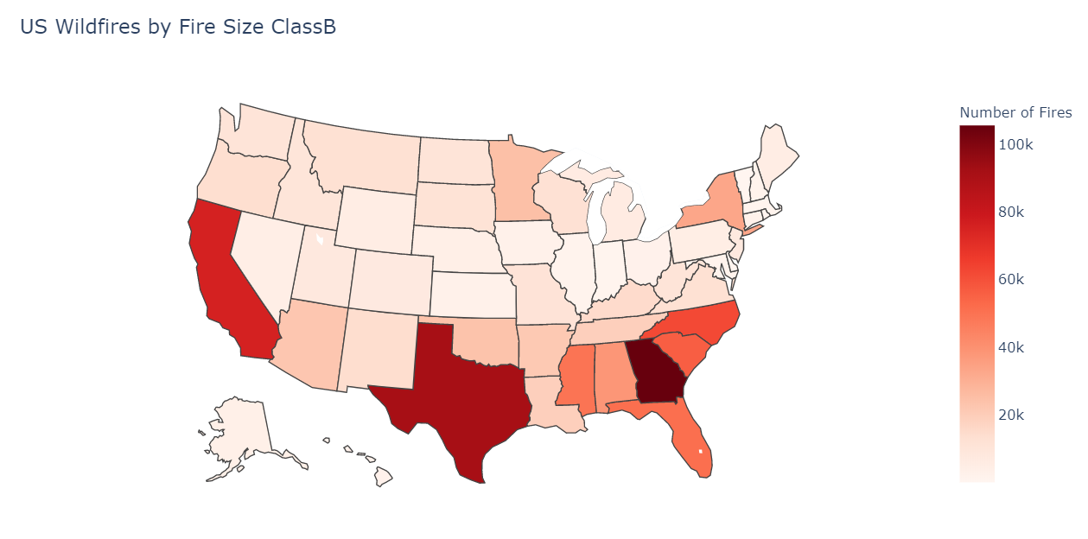
After looking at State maps by Fire size class, we can note that Georgia has most fires with size under 100 acres.
California and Texas have reported fires of all sizes in more numbers over two decades.

Slide 16
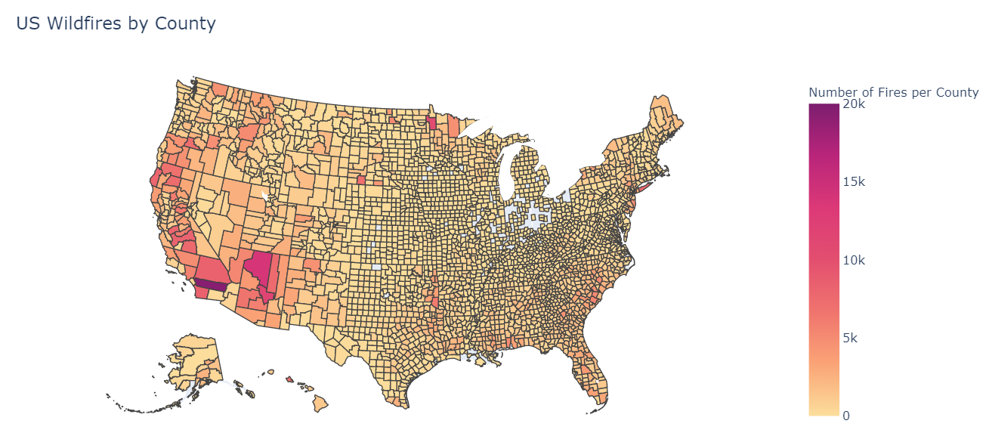
Which County is more prone to Wildfires in USA?
“Riverside County” in California has the most numbers of wildfires.
Below counties comes next in the top list.
“Coconino” and “Gila” in Arizona
“Beltrami” in Minnesota
“San Bernardino” in California
“San Diego” in California

Slide 17
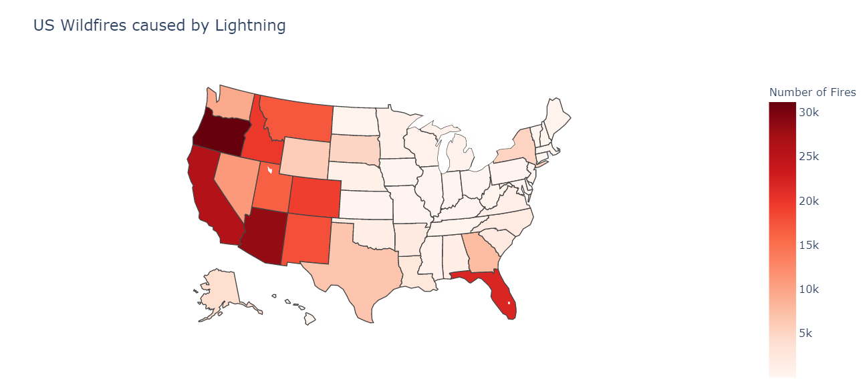
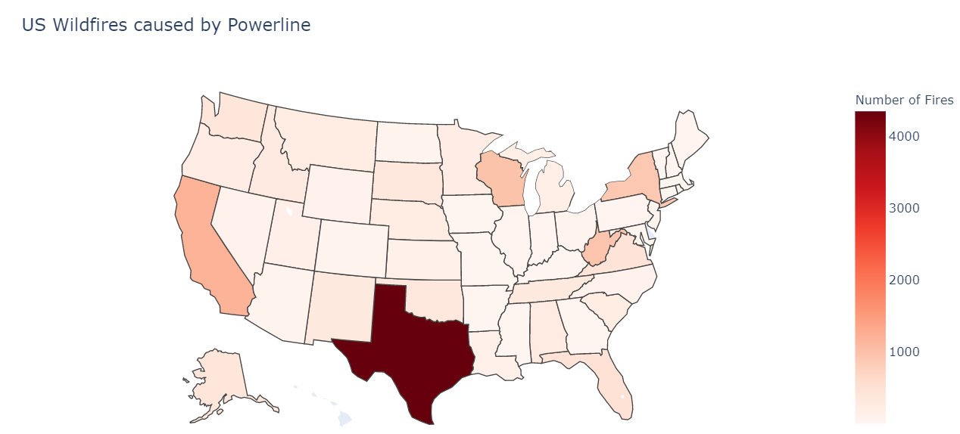
Wildfires in each state with respect to Cause of Fire
The west states of USA has recorded most wildfires caused by “Lightning”.
Florida has recorded 21.8k wildfire caused by lightning
“Powerline” has been stated as cause for over4k wildfires in Texas alone.

Slide 18
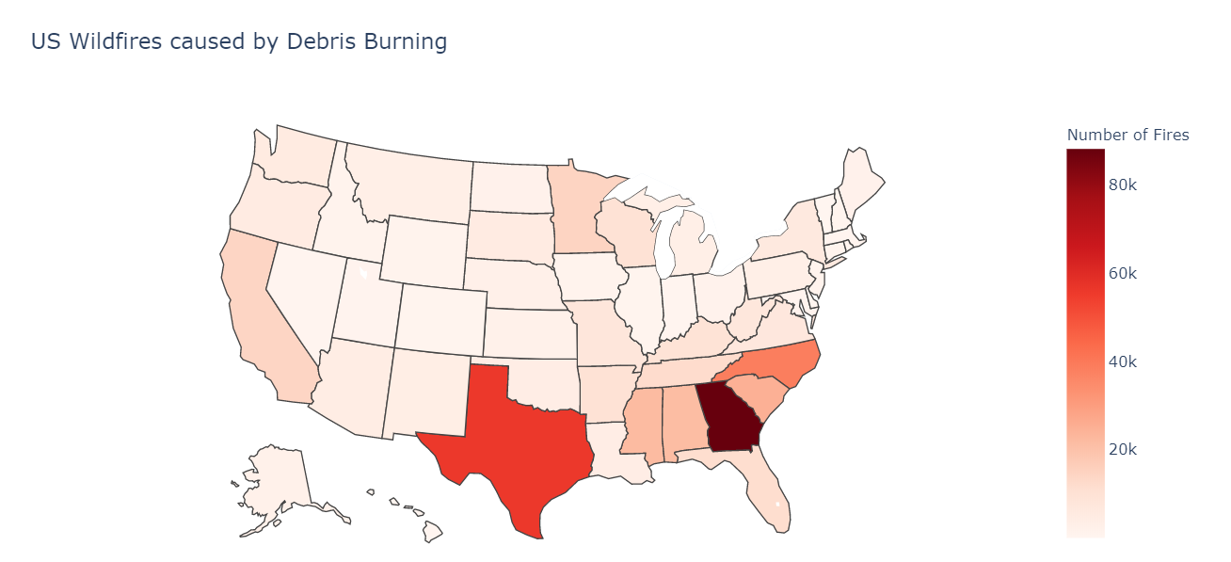
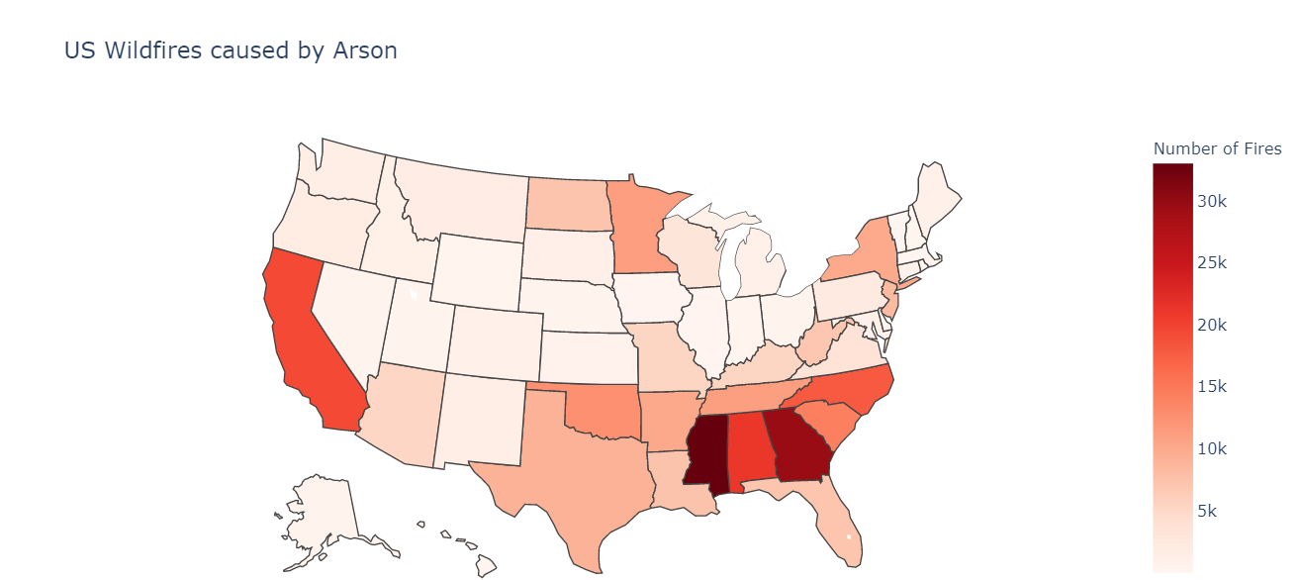
Trash burning is the cause for almost all the cases in Georgia.
Mississippi has 30k wildfires caused by trash burning and arson alone.

Slide 19
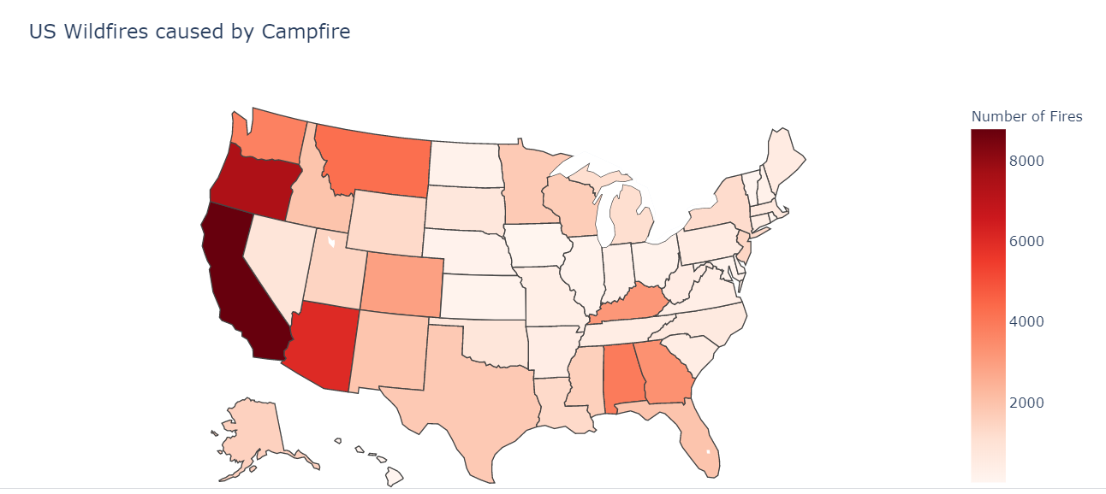
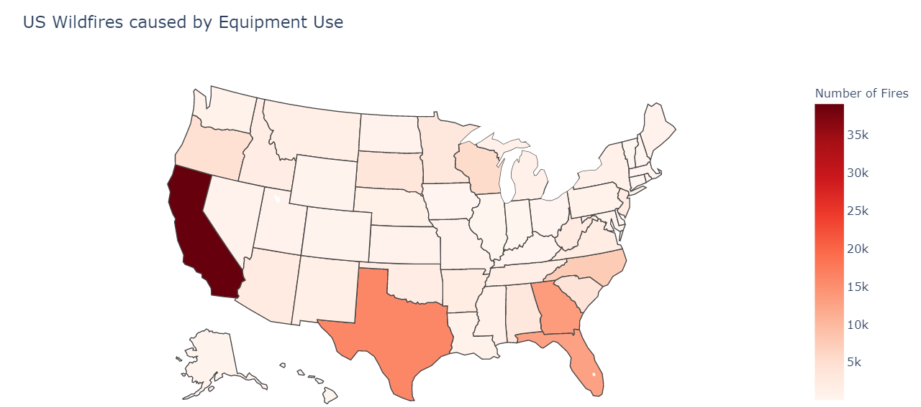
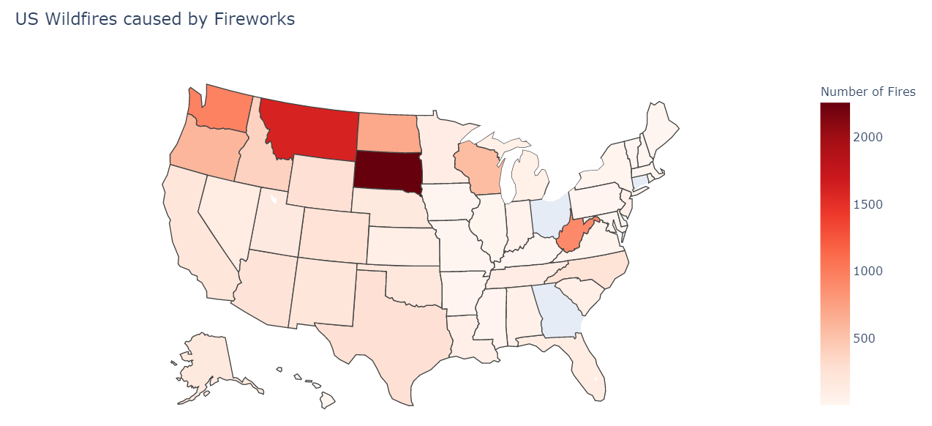
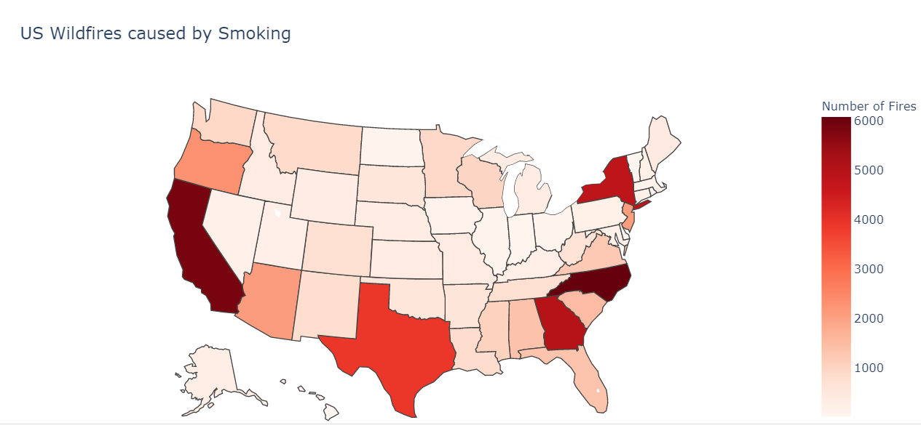

Slide 20
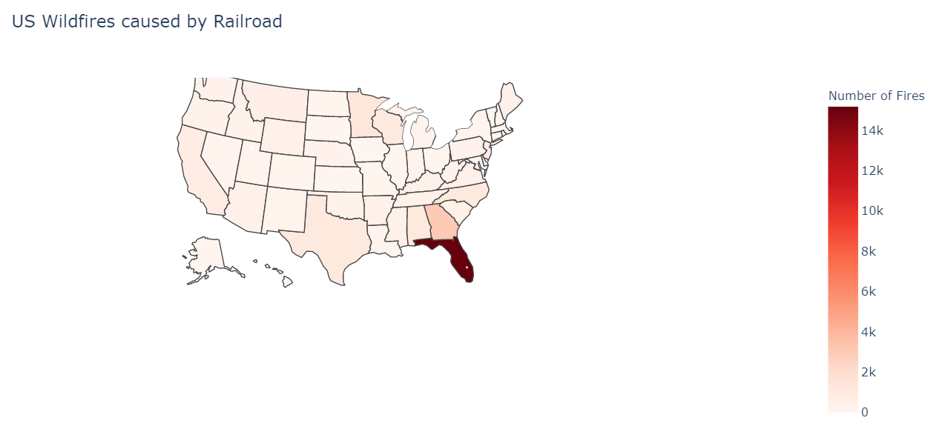
Railroads are causing about 14K wildfires in Florida.
only state majorly affected by Railroad caused wildfires.

Slide 21
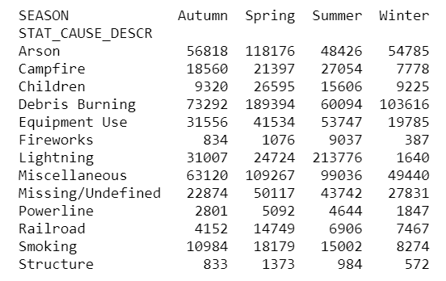
Is the cause of wildfire related to season?
chi-square Test
H0(null hypothesis): The features Cause of Fire and Season are independent (which means they are not associated).
H1(alternate hypothesis): Cause of Fire and Season are not independent (which means they are associated).
p-value=0.000000
At 0.05 level of significance, we reject the null hypothesis and accept H1.
They are not independent.

Slide 22
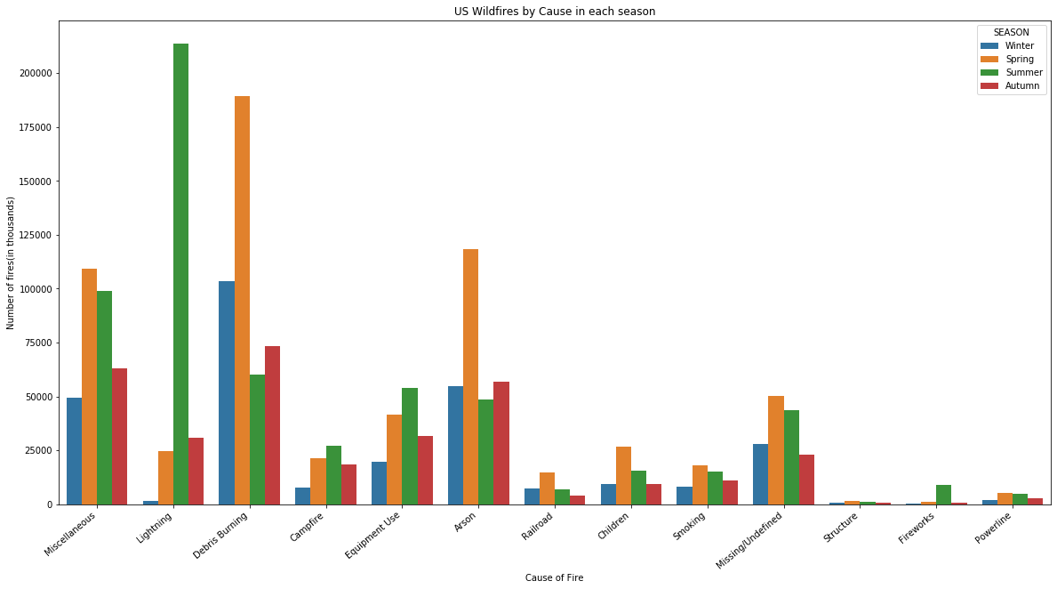
"Cause of Fire" and "Season" are not independent.
we can also note that Lightning during Summer causes most wildfires.
p-value calculated is exactly 0.0. We must treat this value with caution due to the large sample size.

